Slide 1
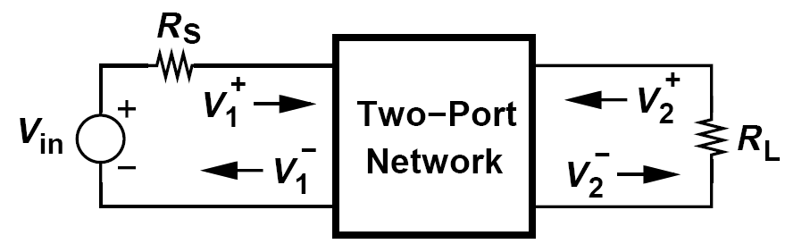
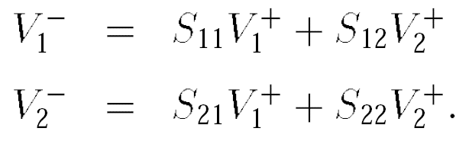
S-Parameters of Two-Port Network
V₁+ is incident wave at port 1, and V₁- is reflected wave at port 1.
The difference between the incident power (the power that would be delivered to a matched load) and the reflected power represents the power delivered to the circuit.

Slide 2
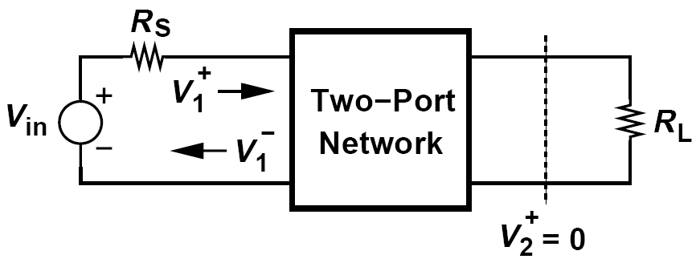
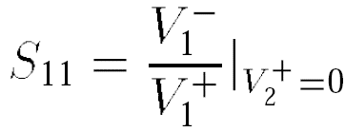
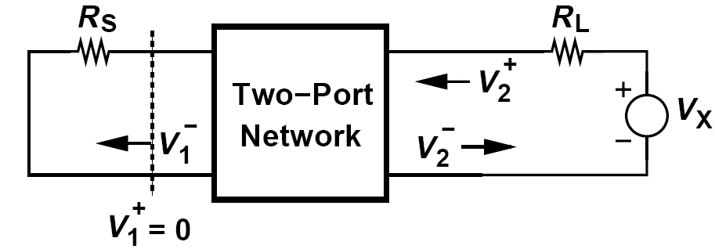
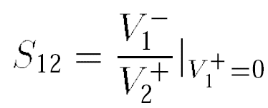
S-Parameters of Two-Port Network
S₁₁ is the ratio of the reflected and incident waves at the input port when the reflection from R_{L} is zero.
Represents the accuracy of the input matching
S₁₂ is the ratio of the reflected wave at the input port to the incident wave into the output port when the input is matched
Characterizes the reverse isolation

Slide 3
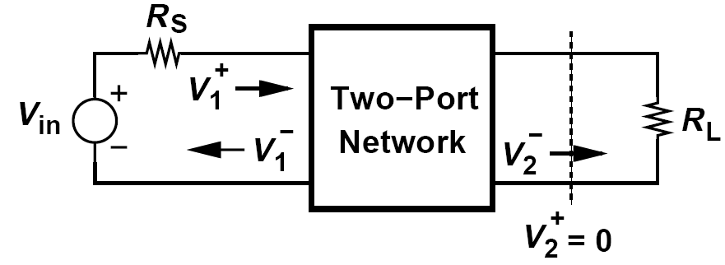
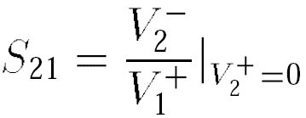
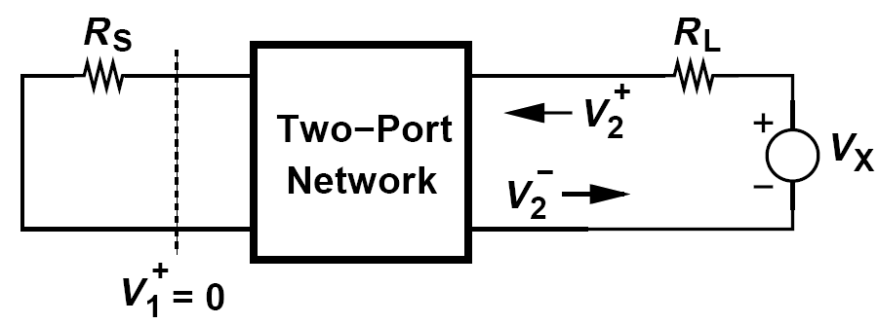
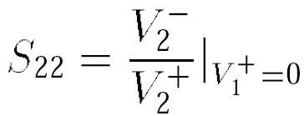
S-Parameters of Two-Port Network
^{S}₂₁ is the ratio of the wave incident on the load to that going to the input when the reflection from R_{L} ^{is zero}
Represents the gain of the circuit
S₂₂ is the ratio of reflected and incident waves at the output when the reflection from R_{s} is zero
Represents the accuracy of the output matching

Slide 4
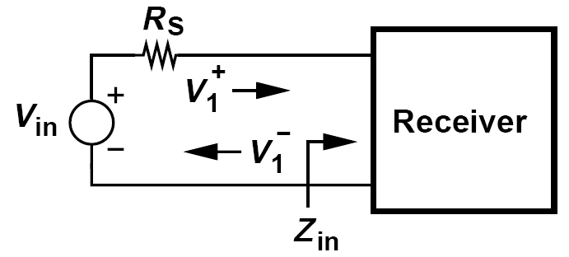
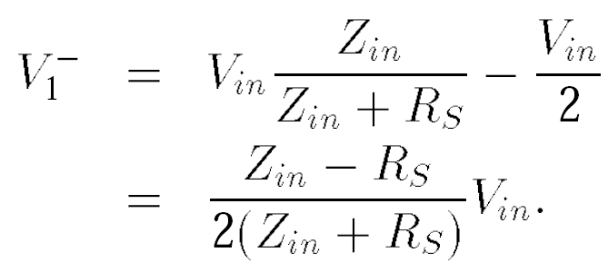
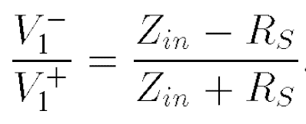
Reflection Coefficient (S₁₁)
^{In modern RF design, S}₁₁ is the most commonly-used S parameter as it quantifies the accuracy of impedance matching at the input of receivers.
Called the “input reflection coefficient” and denoted by Γ_{in}, this quantity can also be considered to be S₁₁ ^{if we remove the condition V}₂⁺ ⁼ ⁰

Slide 5
Impedance matching
Any device with impedance not equal to the characteristic impedance needs to be matched to the characteristic impedance
The Matching Network (MN) needs to be closer to the device.
Once matched to Z0, the impedance does not change with length of the trace – flexibility.
Matching can be done with RF traces (transmission lines and stubs) or using reactive passives (inductors and capacitors) or both.
It is common to use capacitors and inductors because of size constraints.
^{11/10/2016}

Slide 6
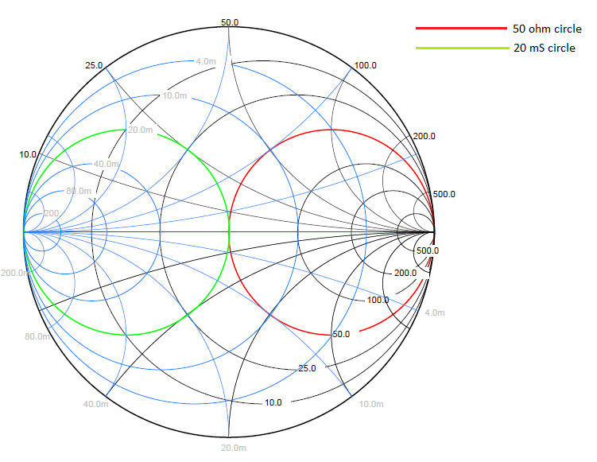
Smith Chart

Slide 7


Impedance Matching
Adding a series inductor moves the impedance along the constant resistance circle clockwise. The inductor value needed to move the reactance on the smith chart by a factor of X_{L} is
L =
Adding a series capacitor moves the impedance along the constant resistance circle in counterclockwise direction. The capacitor value needed to move the reactance on the smith chart by a factor of X_{C} is
C =
Adding a shunt inductor moves the impedance along the constant conductance circle in anticlockwise direction. The inductor value needed to move the conductance by Y_{L} is
L =
Adding a shunt capacitor moves the impedance along the constant conductance circle in clockwise direction. Tha capacitor value needed to move the conductance by Y_{C} is
C =
With this basic information, we can use Smith chart to design matching circuit by using capacitors and inductors to move the impedance to the 50 ohm point.

Slide 8
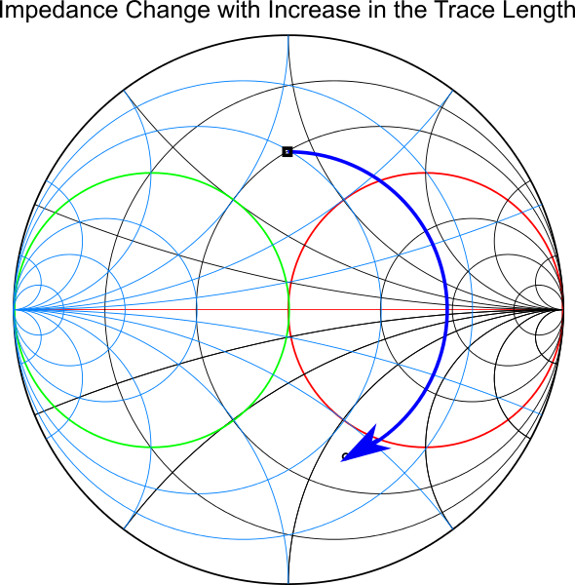
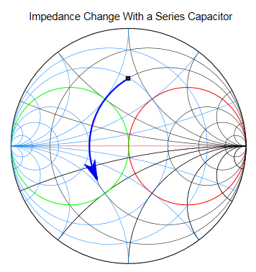
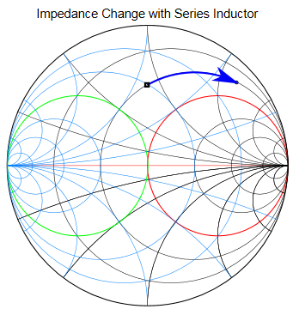
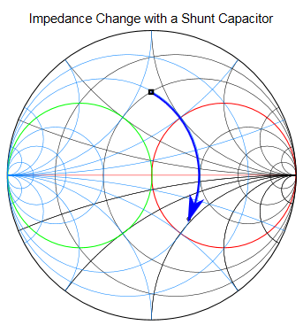
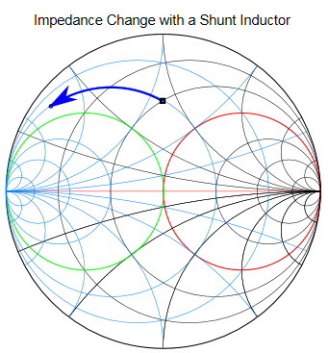
Impedance changes with different components

Slide 9
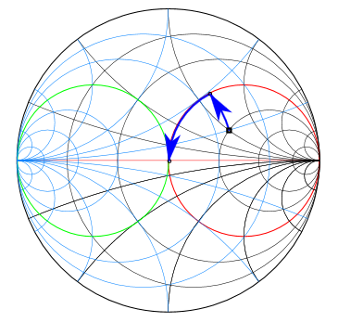
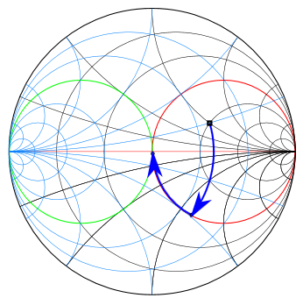
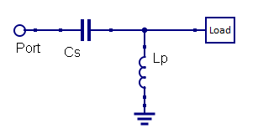
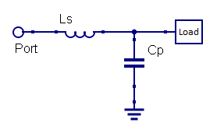
MN – Impedance within 50 ohm circle

Slide 10
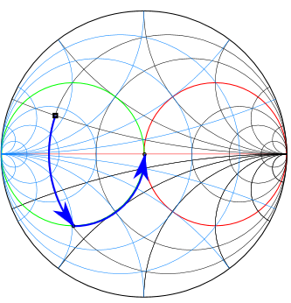
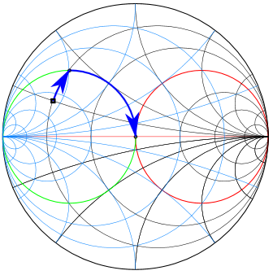
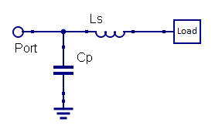
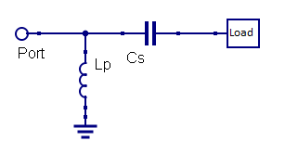
MN – Impedance within 20mS circle

Slide 11
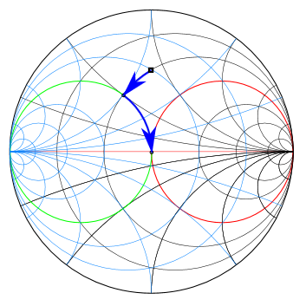
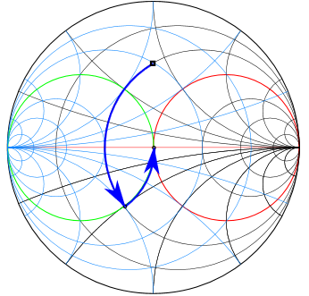
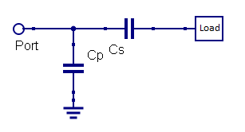
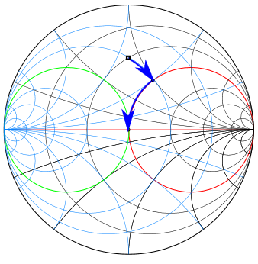
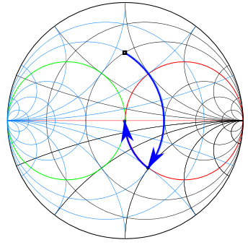
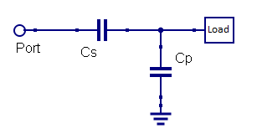
MN- Impedance outside two circles on the top half

Slide 12
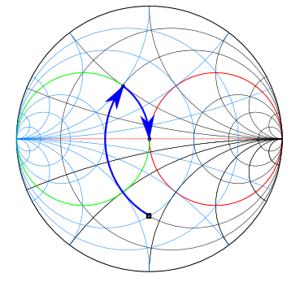
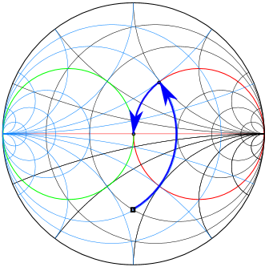
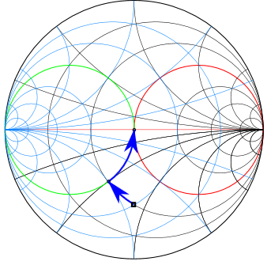
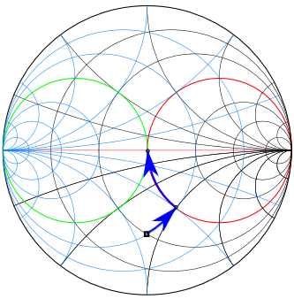
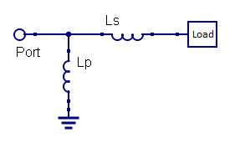
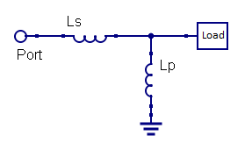
MN- Impedance outside two circles on the bottom half

Slide 13
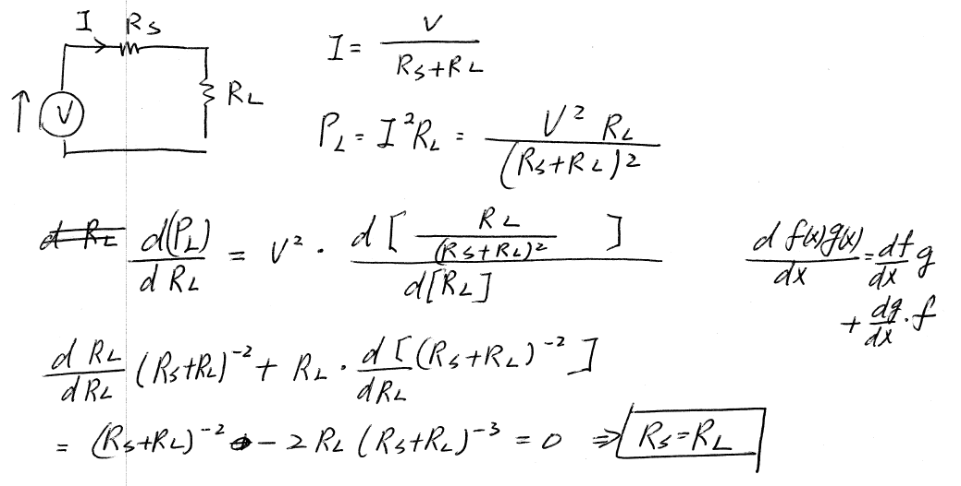
Maximum Power Transfer (Real Impedance)

Slide 14
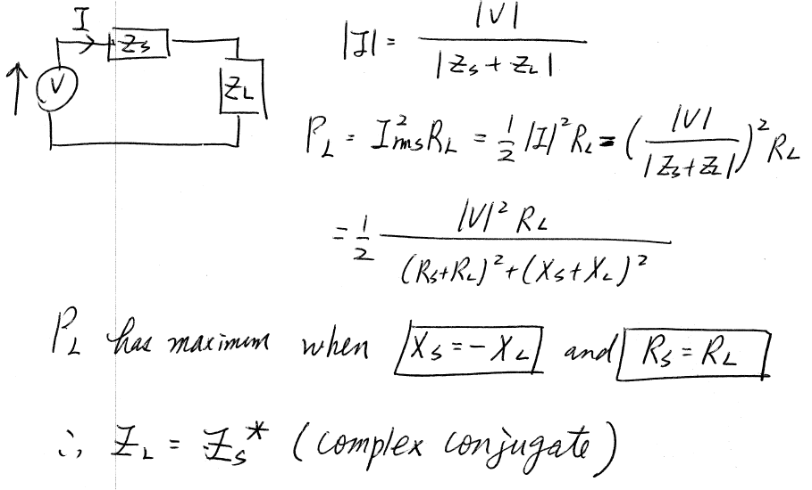
Maximum Power Transfer (Complex Impedance)

Slide 15
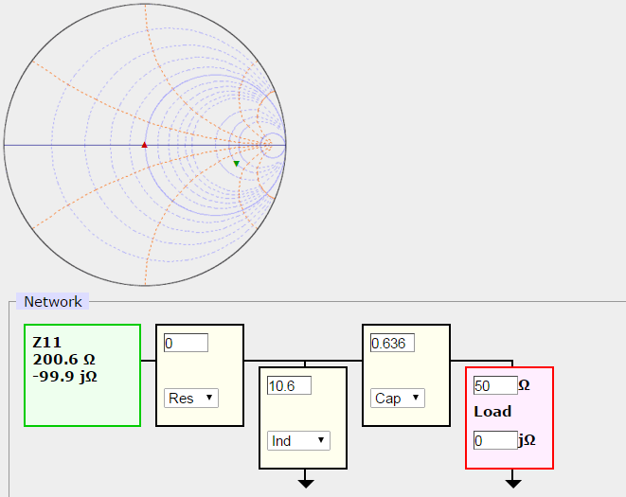
Maximum Power Theorem
The source and load impedances should be complex conjugates of each other in order to achieve maximum power transfer.

Slide 16
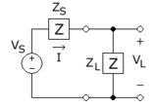

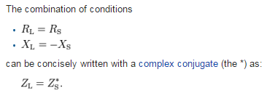
Maximum Power Theorem
The source and load impedances should be complex conjugates of each other in order to achieve maximum power transfer.

Slide 17
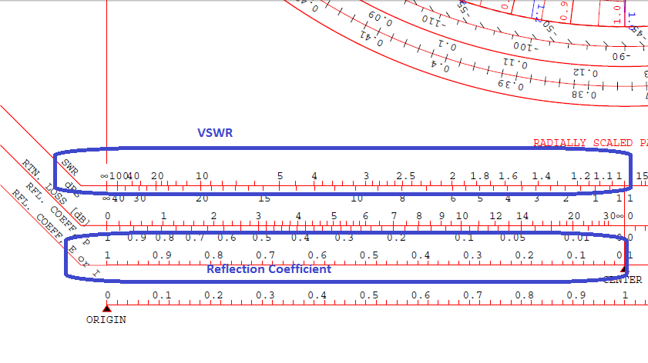

Reflection Coefficient in Smith Chart

Slide 18
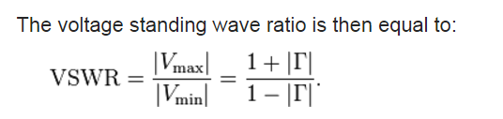
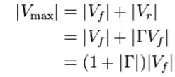
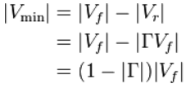
VSWR in Smith Chart

